Slide 1

Analysis Cost of living
By Awais Anwer,
Mentorness Data Analysis Internship

Slide 2
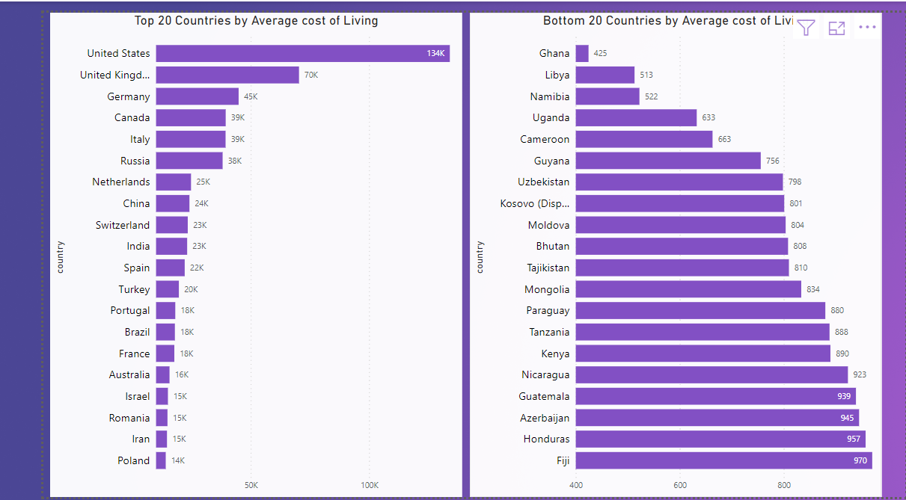
Top and Bottom 20 Countries

Slide 3
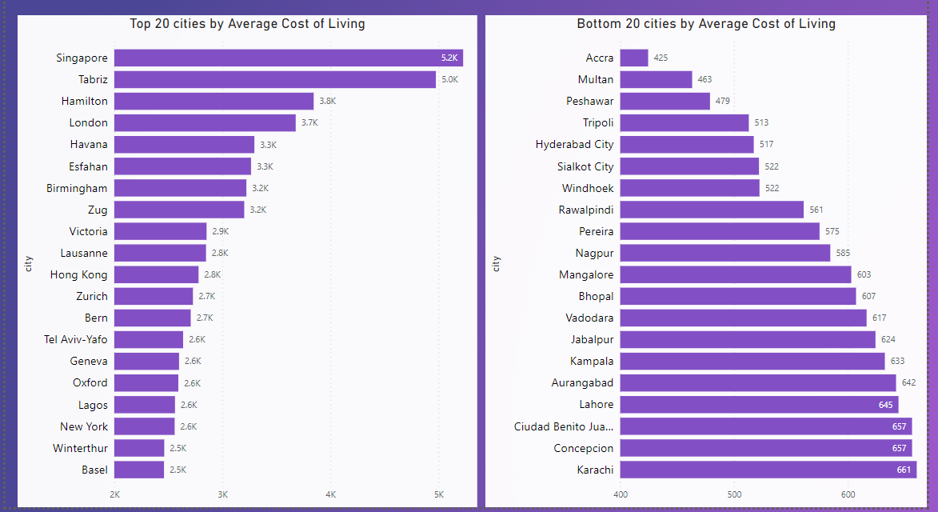
Top and Bottom 20 Cities

Slide 4
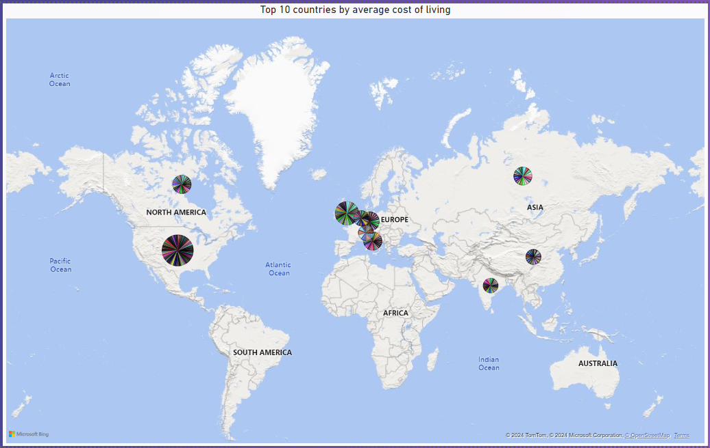
Map View

Slide 5
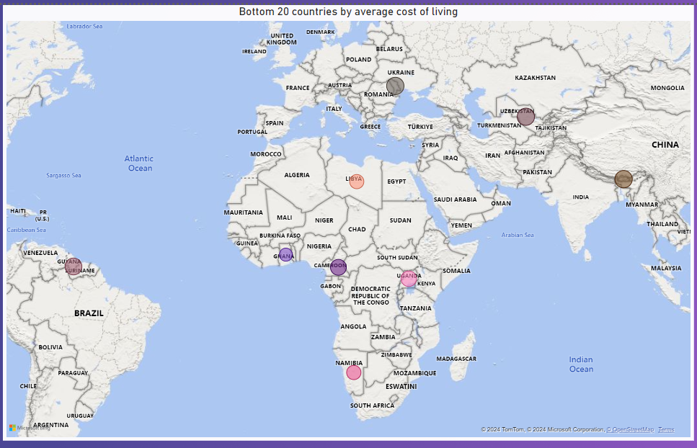
Map View

Slide 6
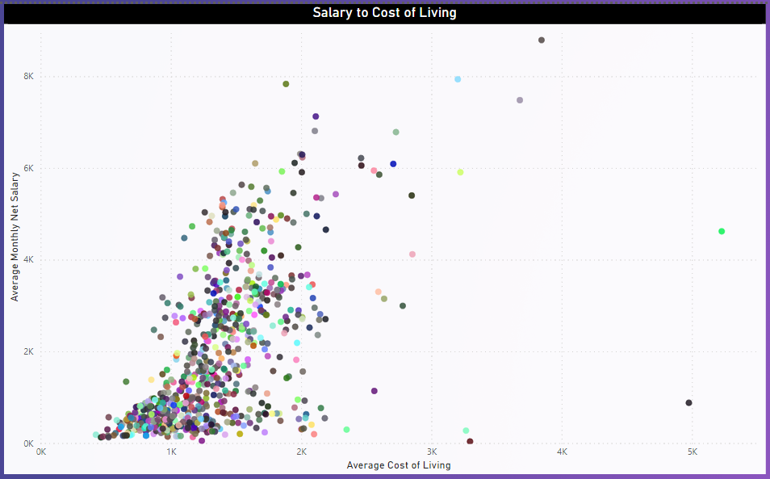
Map View

Slide 7
Thank you
Awais Anwer
Awaislakho350gmail.com

